Slide 1
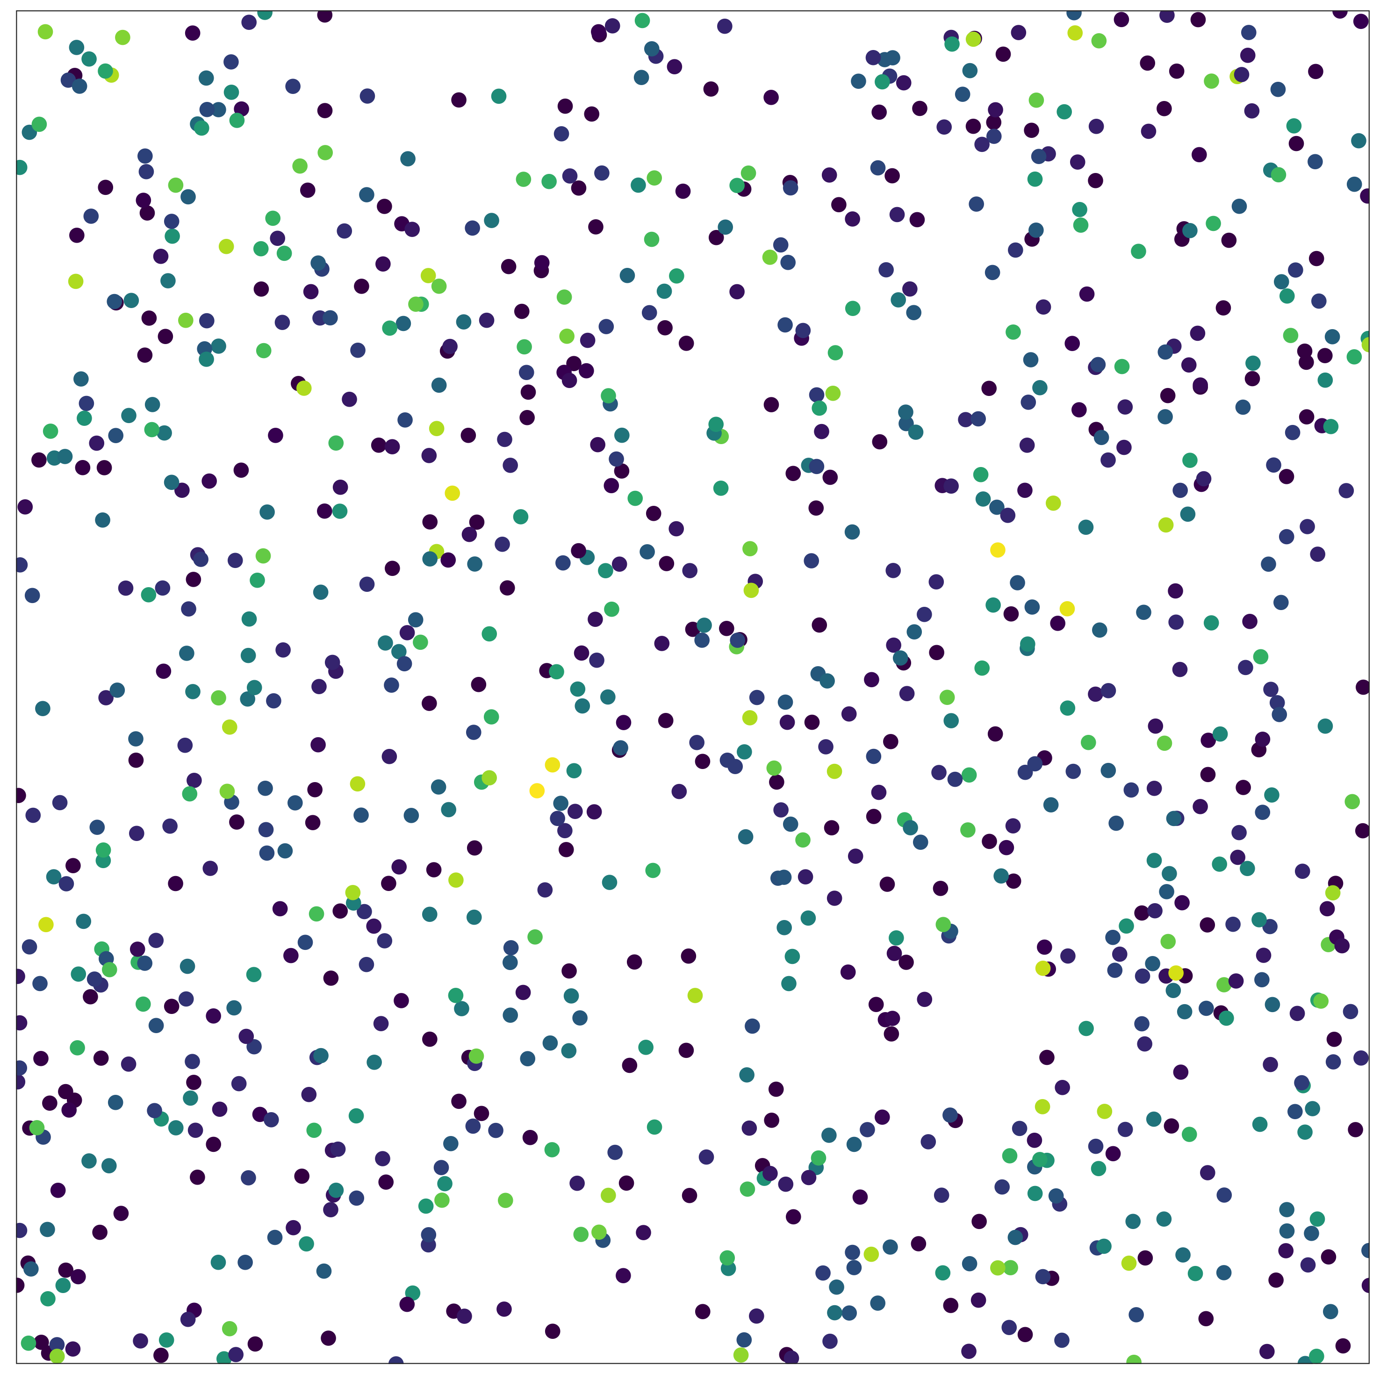
How to measure biodiversity?
Multiple components:
number of individuals (N)
relative abundance of species (evenness)
total number of species (richness)
Different metrics incorporate
these components to varying degrees, but key axes of variation are abundance, evenness and richness (McGill 2011)
Want to use rarefaction to examine:
Component (abundance, evenness and richness) changes , and
Scale-dependent changes

Slide 2
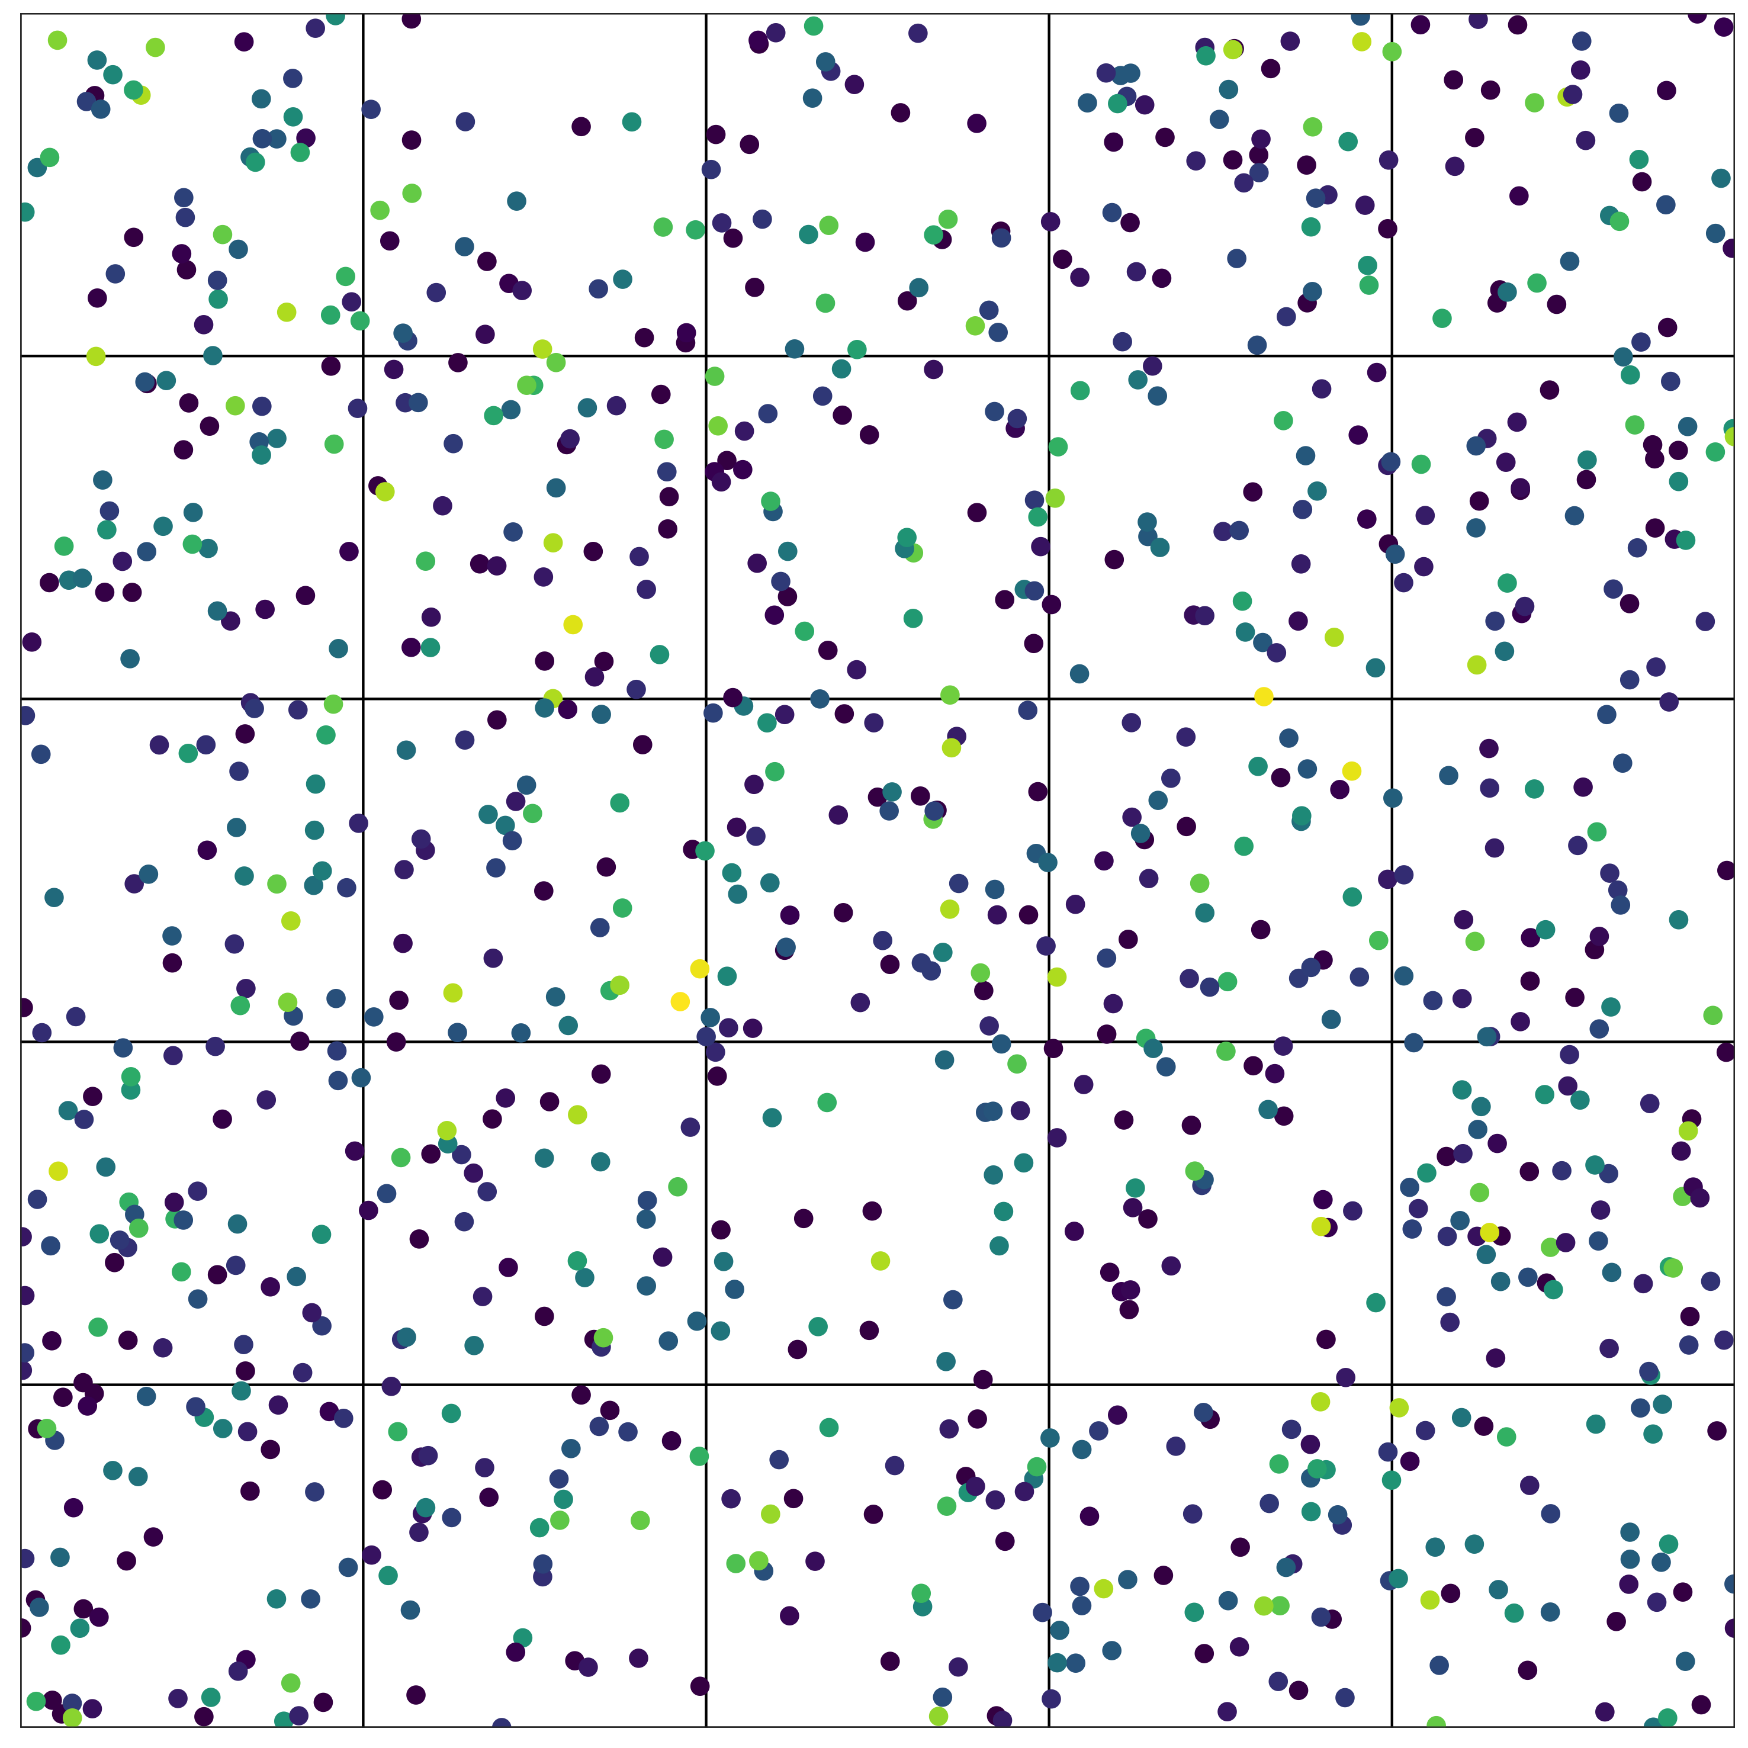
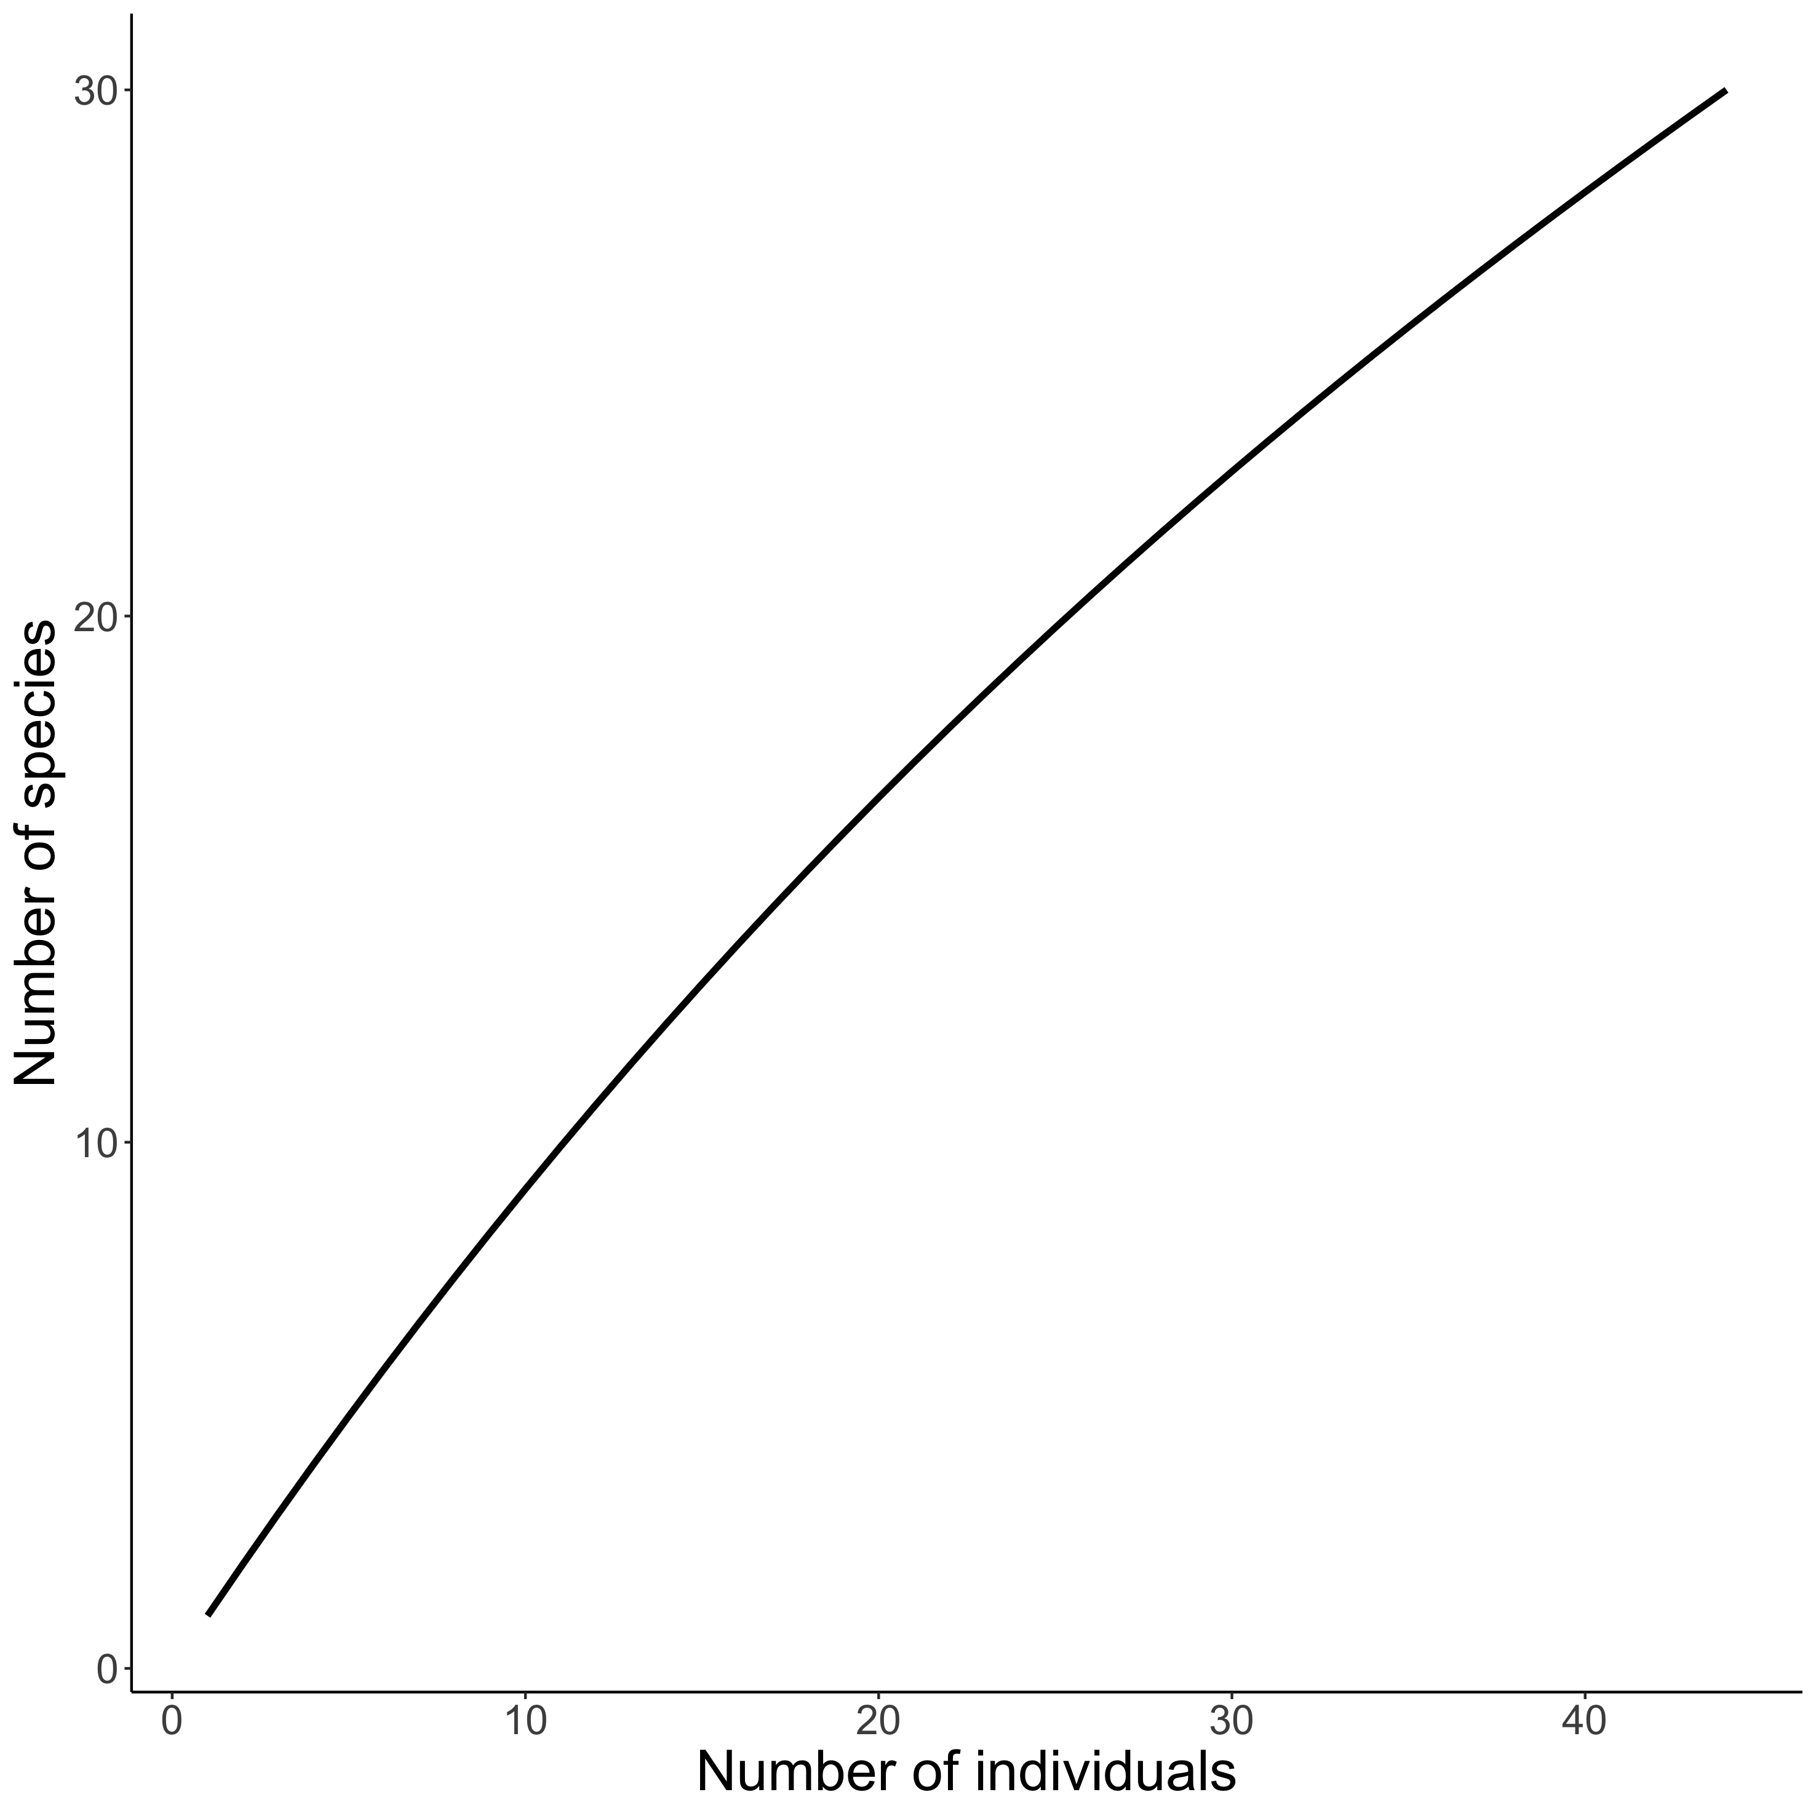
Visualising biodiversity through the lens of Individual Based Rarefaction (IBR)
𝛼-scale
Hurlbert 1971 Ecology, Gotelli & Colwell 2001 Ecol Lett

Slide 3
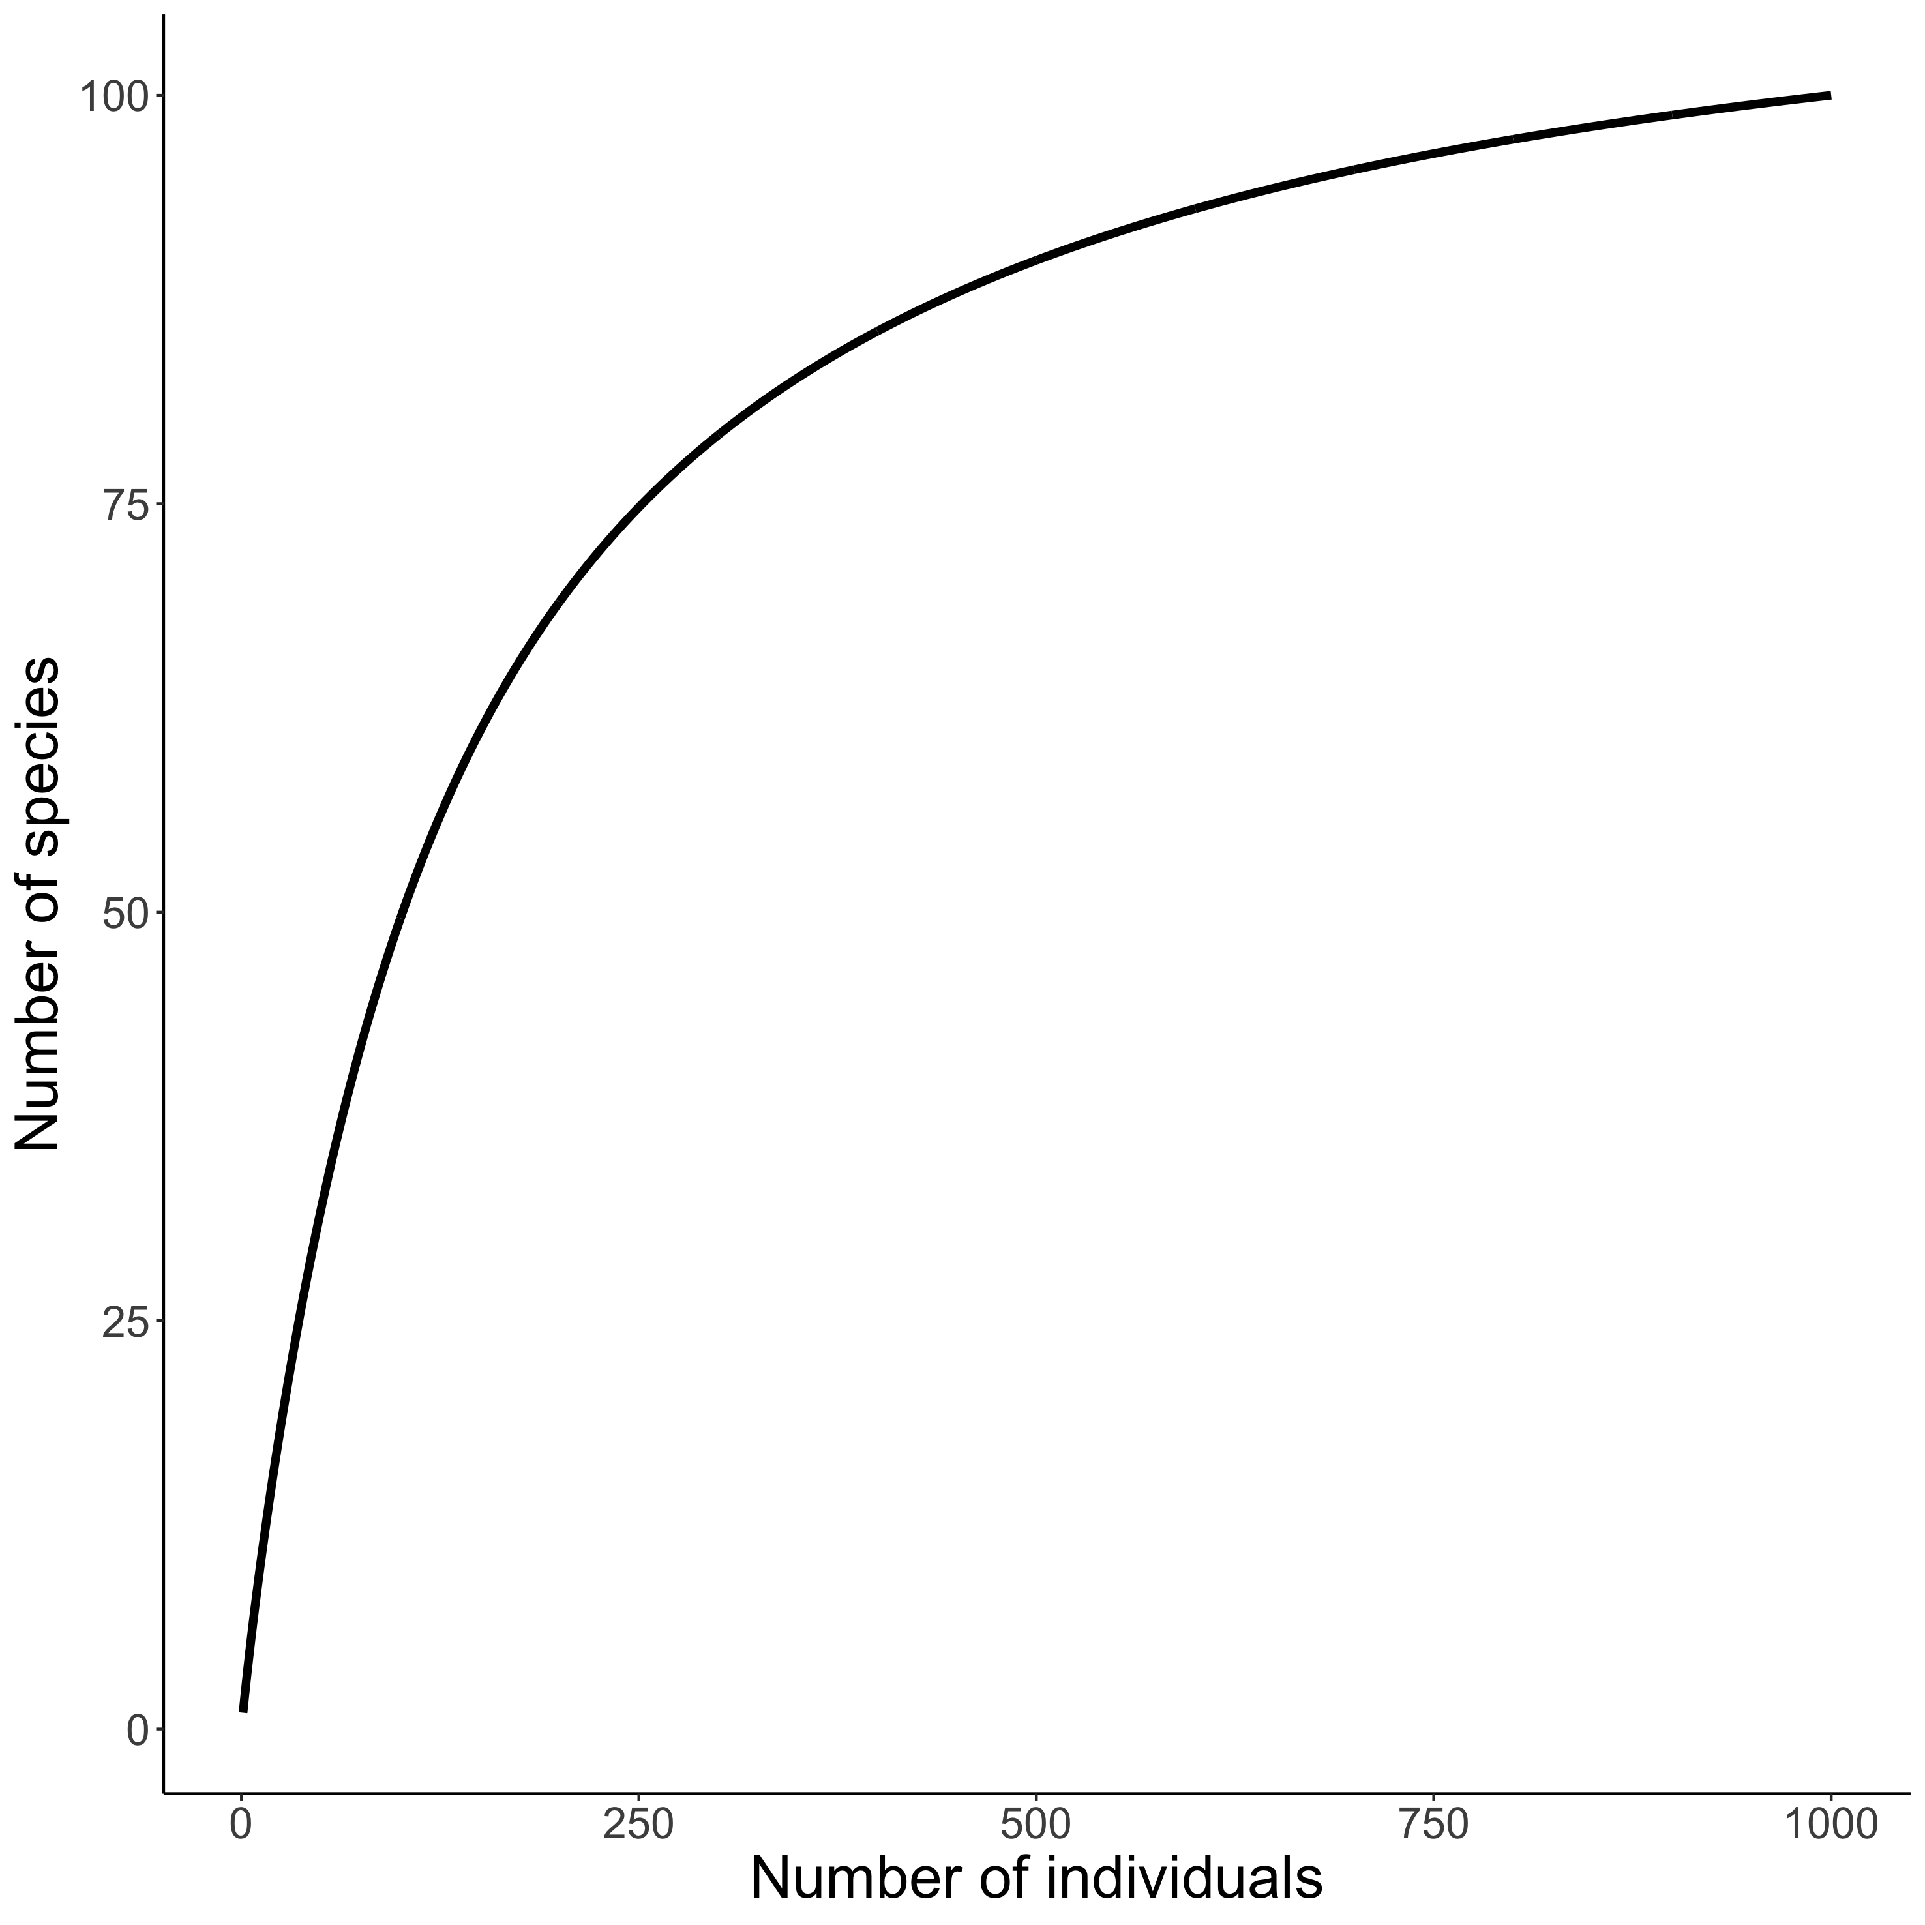
Visualising biodiversity through the lens of Individual Based Rarefaction (IBR)
𝛾-scale
Hurlbert 1971 Ecology, Gotelli & Colwell 2001 Ecol Lett

Slide 4

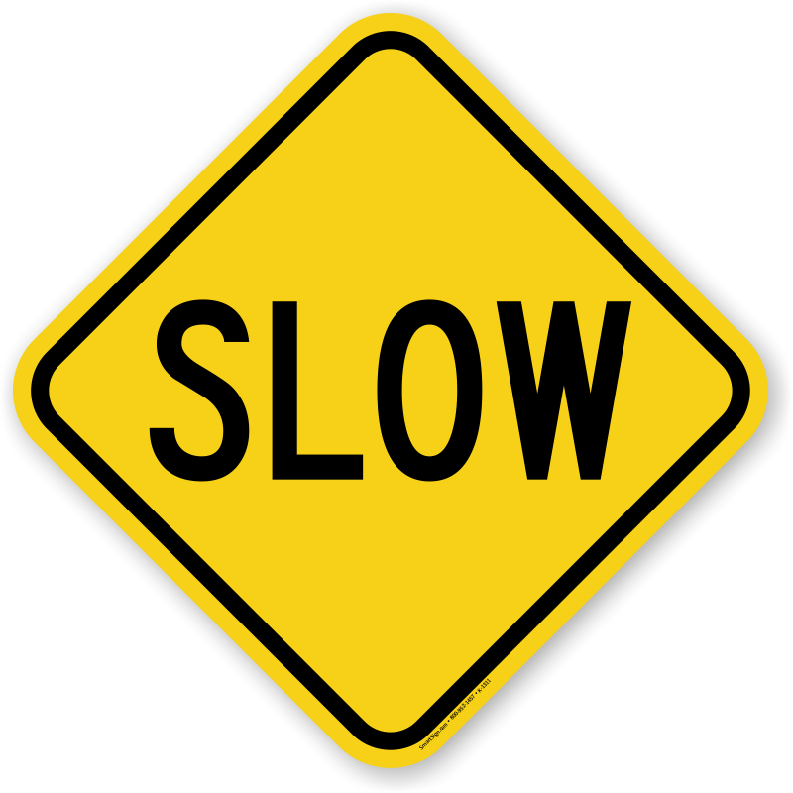
𝛽-diversity scales between 𝛼- and 𝛾-diversity.

Slide 5
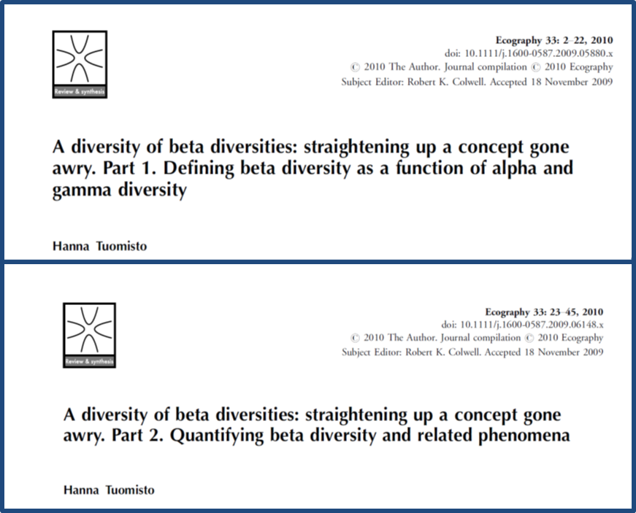


Slide 6
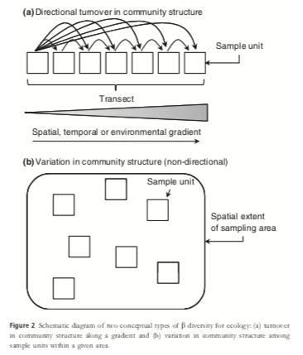
Navigating the multiple meanings of beta diversity: a roadmap for the practicing ecologist
Anderson et al. 2011 Ecology Letters

Slide 7
Navigating the multiple meanings of beta diversity: a roadmap for the practicing ecologist
Anderson et al. 2011 Ecology Letters

Slide 8
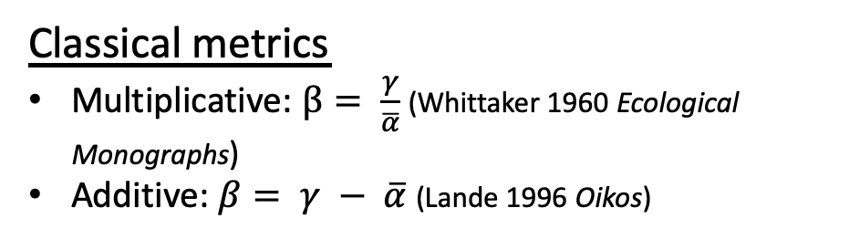
Navigating the multiple meanings of beta diversity: a roadmap for the practicing ecologist
Classical metrics
Multiplicative: $β= \frac{γ}{\overline{α}}$ (Whittaker 1960 Ecological Monographs)
Additive: $β= γ − \overline{α}$ (Lande 1996 Oikos)
Anderson et al. 2011 Ecology Letters

Slide 9
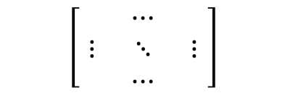
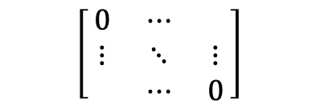
Navigating the multiple meanings of beta diversity: a roadmap for the practicing ecologist
Multivariate metrics
Community matrix:
Species
$$\left[\begin{matrix} & ⋯ & \\ ⋮ & ⋱ & ⋮ \\ & ⋯ & \end{matrix}\right]$$
Sites
Dissimilarity matrix: d_{ij}
Pair-wise dissimilarities among the samples
$$\left[\begin{matrix}0 & ⋯ & \\ ⋮ & ⋱ & ⋮ \\ & ⋯ & 0\end{matrix}\right]$$
Anderson et al. 2011 Ecology Letters

Slide 10
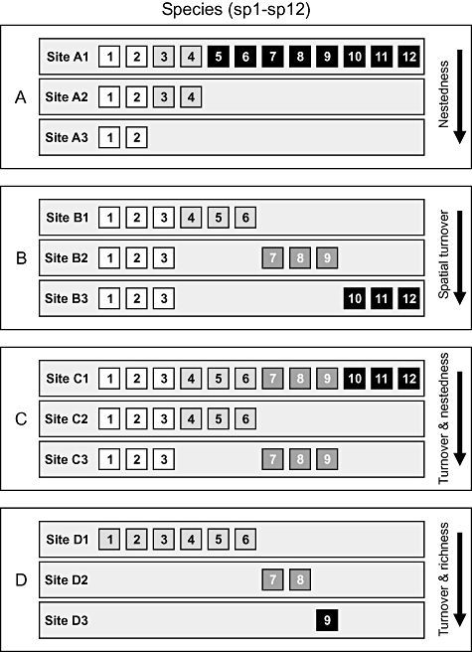
What about partitioning the dissimilarities?
Baselga 2010 Global Ecology & Biogeography

Slide 11

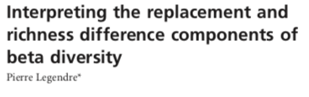
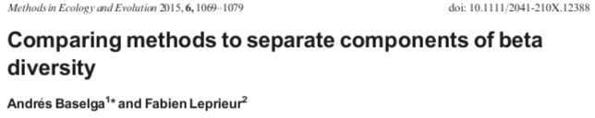
What about partitioning the dissimilarities?
But, these are not without there critics either…
Baselga 2010 Global Ecology & Biogeography

Slide 12
Measurement of Beta-diversity I
Combine rarefaction curves from 𝛾- and 𝛼-scales to calculate ‘Whittaker’ 𝛽-scale metrics
Chase et al. 2018 Ecology Letters

Slide 13
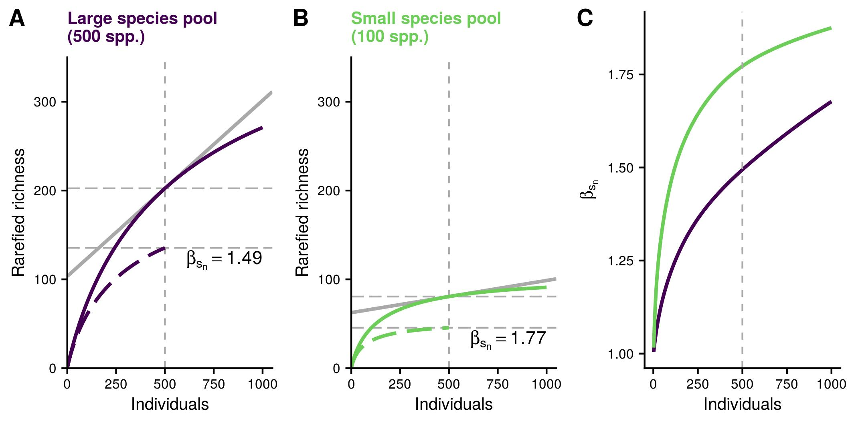
Measurement of Beta-diversity II
Engel et al. 2020 bioRxiv

Slide 14
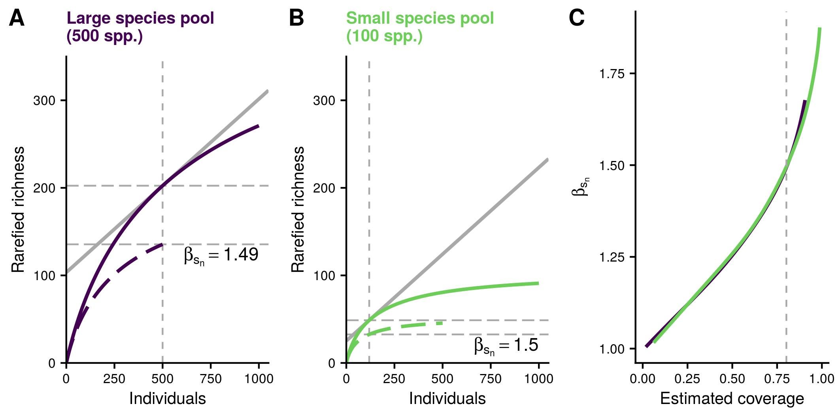
Measurement of Beta-diversity II
Engel et al. 2020 bioRxiv

